Slide 1
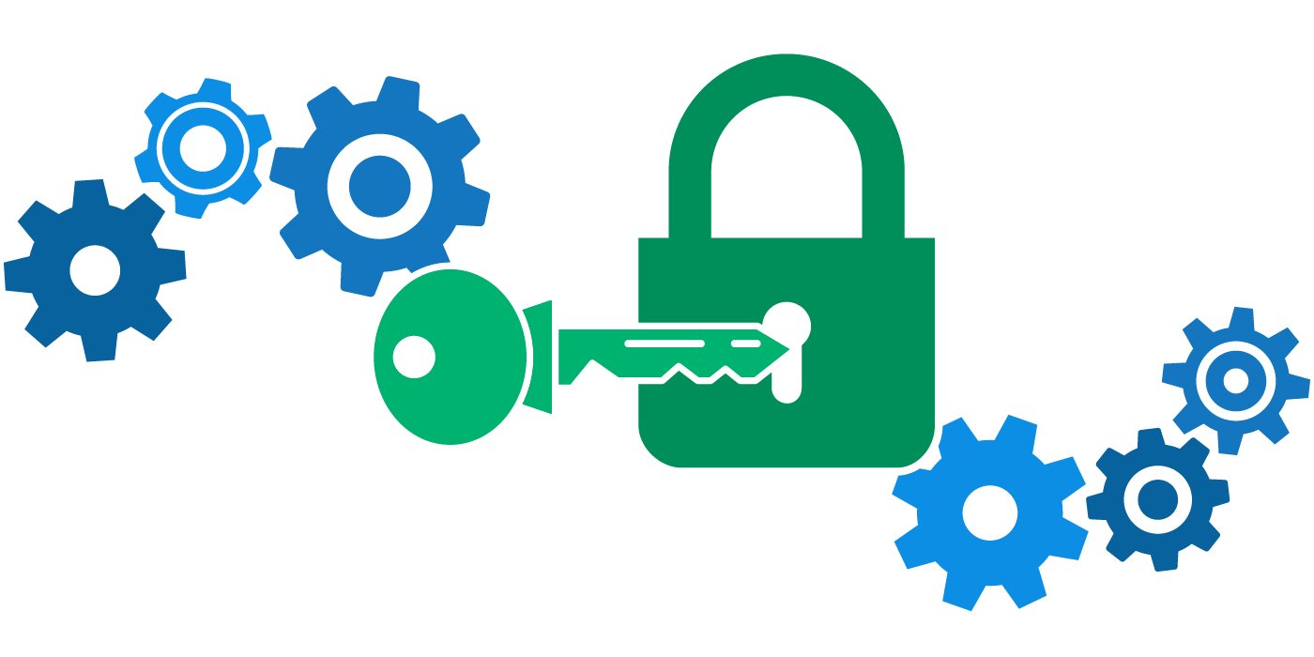
ssh & encryption
Week 2
Google Slides Version

Slide 2
slides changelog
04/07: Added slide on X servers.
04/09: Added hints for lab and hw (end of slides).

Slide 3
week 1 review
Are we all clear on…
→ PATH variable?
→ environment variables?
→ symbolic vs hard links?
→ inodes?

Slide 4
week 2 assignment
Due next Monday, April 13th.
You’ll use a few different ssh commands to do a multi-hop (ssh from one server to the next), digitally sign a key, and answer a few questions on security.
We’ll go through some of the assignment in class on Thursday.

Slide 5
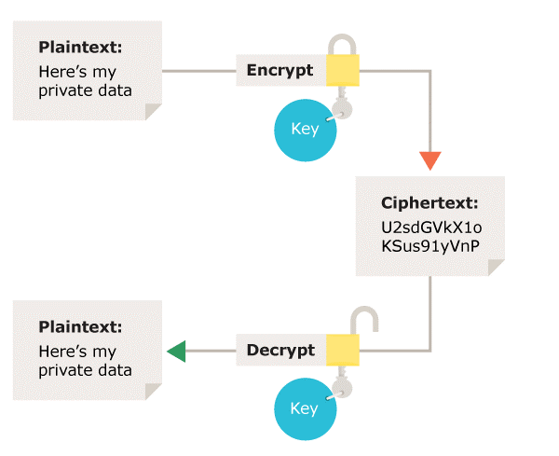
encryption
We take original data (plaintext) and apply some kind of encryption algorithm - a cipher - to create scrambled data (ciphertext). We then use some kind of decryption algorithm to unscramble the data again. To be effective, ciphers use particular variables ( keys) that makes output unique.

Slide 6
ciphers and keys
example: Caesar’s cipher, one of the earliest examples of encryption
plaintext: here’s my credit card info
cipher: shift all letters of the alphabet by some number n
key: 3 (so a → d, b → e, etc.)
ciphertext: khuh'v pb fuhglw fdug lqir

Slide 7
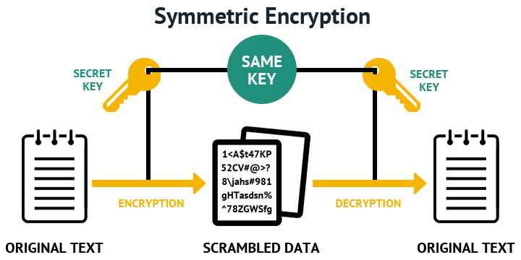
symmetric encryption
All parties (senders and receivers) share the same secret key, so they can all encrypt and decrypt messages sent to each other.
pros: fast
cons: how does everyone get this shared key?

Slide 8
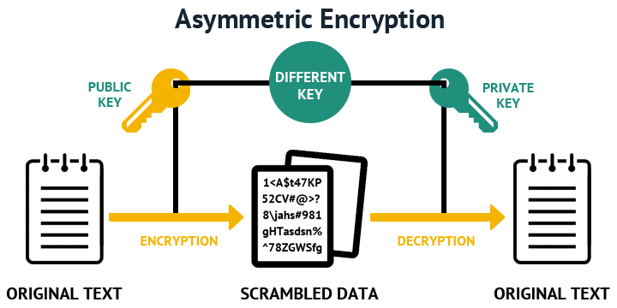
asymmetric encryption
Two different, linked keys are used to encrypt and decrypt data. You can encrypt and send using a public key, but you can only decrypt messages sent by the public key using your linked private key.
pros: no longer reliant on a single point of failure
cons: slower than symmetric

Slide 9
symmetric + asymmetric
Today, a lot of encryption uses a combination of both - a symmetric algorithm to encrypt data, and an asymmetric algorithm to exchange the shared secret key safely.
Large prime numbers are often used to generate these keys, because it’s computationally difficult for most computers to factor these and reverse engineer keys in that way. RSA, the most common asymmetric encryption, uses this.

Slide 10
symmetric + asymmetric
Alice needs to send her credit card info to Bob. To make sure her message isn’t intercepted by anyone else, she knows she needs to encrypt it. Alice has a public-private key pair, and Bob has a public-private key pair.
→ Alice creates a secret key. She encrypts it with Bob’s public key.
→ Bob receives an encrypted message from Alice. He decrypts it with his private key. He now has a copy of the secret key!
→ Alice now encrypts her credit card info with her secret key and sends it over to Bob.
→ Bob receives an encrypted message from Alice, and decrypts it with the shared secret key.

Slide 11
secure shell
Provides a secure way to connect across an unsecured network.
SSH protocol uses the symmetric + asymmetric encryption process, plus some hashing, to generate a secure connection. When two machines are running ssh and connect, the first few messages they exchange will be setup to agree to encryption protocols and exchange keys.
SSH also needs to authenticate a user after keys are given, and usually does so by asking for a password. You can also be authenticated by adding a set of SSH key pairs to prove your identity.

Slide 12
ssh
SSH is both a protocol and a suite of tools used to run commands from the terminal.
In your assignment for this week, you’ll use some of these commands to set up slightly more complex ssh connections than you have been doing so far.

Slide 13
X Servers
To see graphical displays (instead of just everything in the terminal), you’ll need to download an X server and ssh with that enabled.
→ For Mac users, download XQuartz, and then ssh using ssh -X <your_username@whatever.edu> or ssh -Y <your_username>@whatever.edu
→ For Windows users, download XMing. In Putty, or whatever ssh client you’re using, there should be a box in SSH settings to enable X11 forwarding. Check that, and then start your ssh session.
Check that your X-forwarding worked by typing in the command xeyes and seeing if any other window pops up. If you get an error instead, X-forwarding hasn’t been correctly enabled.

Slide 14
Assignment 2: Lab Hints
Part 1:
→ You should be able to generate key pairs on a ‘host’ server, copy your public key to another ‘remote’ server, log out of the SEASnet servers, log back into your host server, start up the ssh-agent and add your private key to the agent, then ssh into the remote server without being asked for your SEASnet password
→ For X-forwarding, you should be able to open an ssh connection with X-forwarding, type in xeyes, and have another window pop up
→ For multi-hopping, you should use one of the two methods discussed here to hop between three servers.

Slide 15
Assignment 2 HW Hints
GPG:
→ create a key pair using gpg and export public key into file hw-pubkey.asc. Use this link to create the key-pair and this link to export it.
→ Create a detached signature called hw-pubkey.sig for hw-pubkey.asc and verify it. Use this link for help on these steps (note that you need to create a detached signature).

Slide 16
Assignment 2 HW Hints
Security Questions:
“Observing bytes going across network” = reading messages sent between your host and remote machine. In this case, messages are commands you typed and output you received back.
Tapping keystrokes = they have a record of every keyboard button you entered after you setup your password free ssh connection.
Booting off USB = they have your live USB - a USB that, when plugged into a computer, contains the entire OS and all of that account’s files.
GPG digital signatures tell you that the person that created the file and the person that signed the file are the same person. Think about what information GPG isn’t giving you in this case.

